Slide 1
Crazyflie P&S
This is the Crazyflie PPS Presentation

Slide 2
What is a Crazyflie?
A Crazyflie is a Quadcopter

Slide 3
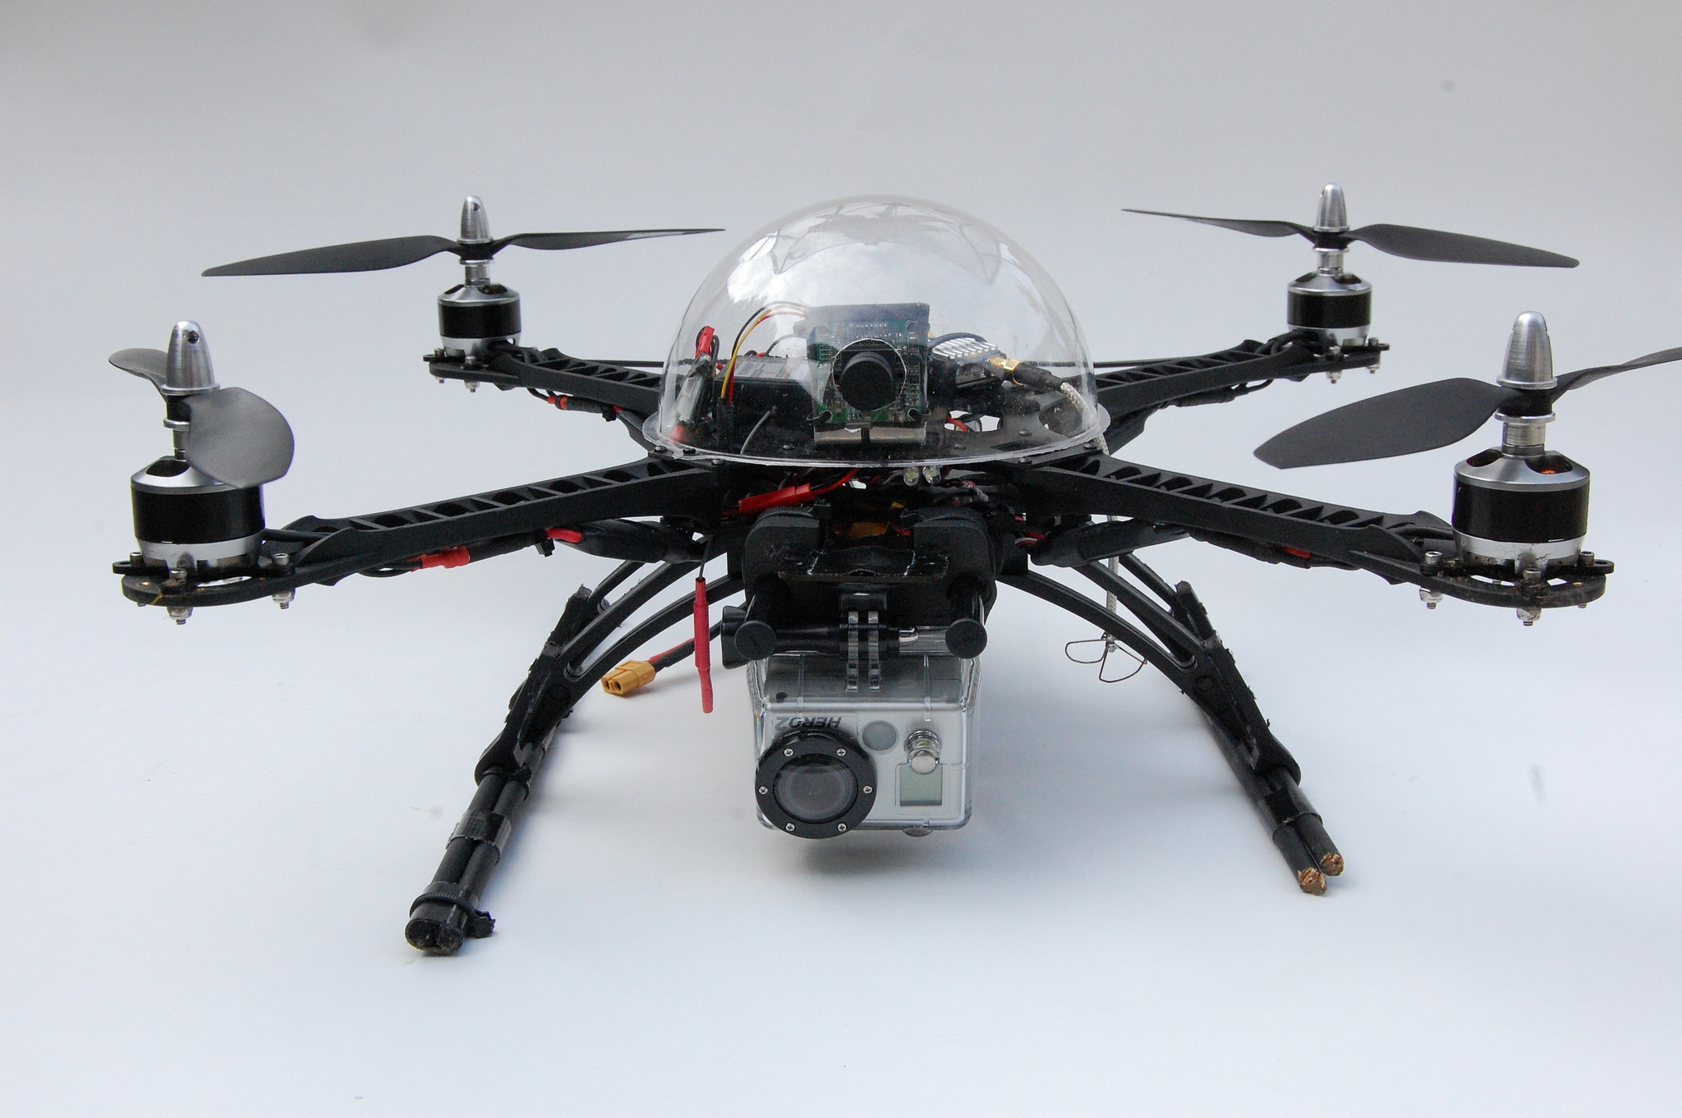
Pictures of Quadcopters

Slide 4
Pictures of Quadcopters
Source: <div class="detail__media detail__media--images"><div class="detail__media__img-wrapper js-image-detail-wrapper" style="transform: scale(1);"><a style="width:711.2364170337738px;height:473px;top:;" href="http://traviseric.com/wp-content/uploads/2014/09/7145758439_424b92b427_k.jpg" class="detail__media__img-link js-detail-img js-image-detail-link" target="_blank"><div style="width:710px;height:472px;" class="detail__media__img-bg js-detail-img js-detail-img-bg"></div><img src="https://images.duckduckgo.com/iu/?u=https%3A%2F%2Ftse4.mm.bing.net%2Fth%3Fid%3DOIP.YfWp7wNUeaRZnT_wFoamIwEsDH%26pid%3D15.1&amp;f=1" style="width: 711.236px; height: 473px; display: none;" class="detail__media__img-thumbnail js-detail-img js-detail-img-thumb"><img style="width: 711.236px; height: 473px; display: block;" alt="NASA Expert Helps Me Design Quadcopter Drone" class="detail__media__img-highres js-detail-img js-detail-img-high" src="https://images.duckduckgo.com/iu/?u=http%3A%2F%2Ftraviseric.com%2Fwp-content%2Fuploads%2F2014%2F09%2F7145758439_424b92b427_k.jpg&amp;f=1"></a></div></div>

Slide 5
Thank you for your attention
Thank you for your attention

